Slide 1
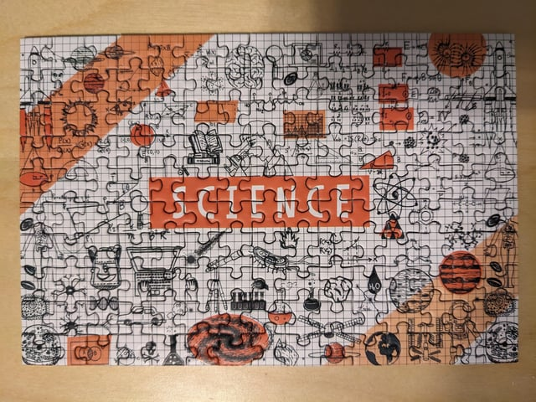
Today’s Goals
Finish up Lorentzian Fitting
Reminder of the Big Picture Course Goals
Reviewing Lab Notebooks
Discussion of Next Week’s Assignment
Building a Story Particularly When Unclear and/or Unfinished
Notes:
Femi is going to finish off what he was showing on Lorentzian fitting, since we ran out of time last time.

Slide 2
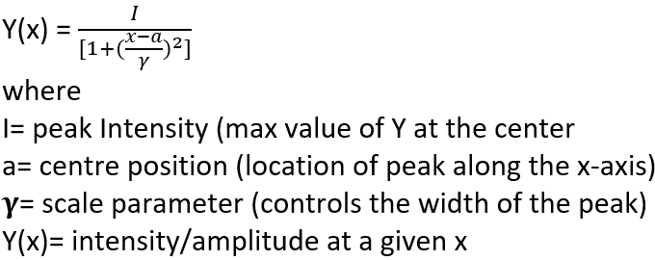
Reminder of Example from Last Time
Multiple peak Lorentzian fit in Excel (user-friendly but other options)
I = peak intensity
a = location of peak
Gamma related to peak width
Intensity (a.u.)
Raman Shift (cm⁻¹)
Notes:
Sometimes I use color to remind myself of the things I want to emphasize:
Lorentzian example, but you could use a similar approach for Gaussian fits or others
Excel/other: Last time, we discussed other ways to fit data, but Excel seems to be a program that seems to be more comfortable with beginners. It is by no means perfect, but it’s a good place to begin, particularly if you are already feeling a little overwhelmed. If not, feel free to explore other options, but I won’t be able to provide guidance in all them. I’m not an expert in all of them. Feel free to ask the other TAs too, as many of us have different preferences in the programs we use.

Slide 3
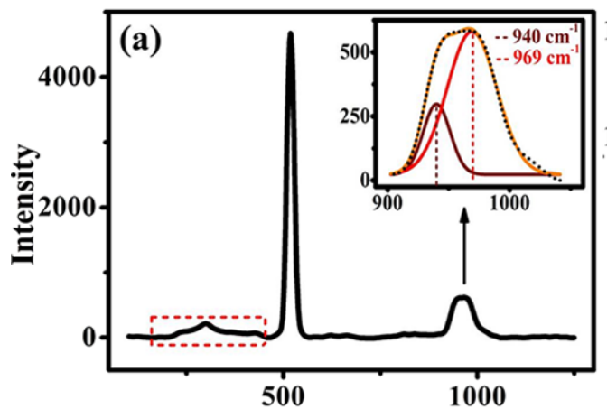
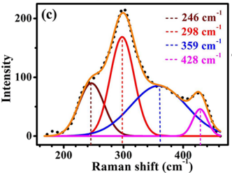
You are not required to do fitting, but it would be nice to identify peak locations if you have clear peaks. It’s good practice if you have time. We are more interested in identifying the peaks.
Additional Materials (on class website too):
Microsoft Excel: Fitting data to a Lorentzian Peak (how to plot one). You could do similarly with other kinds of fitting too (Gaussian)
Fitting to Lorentzian with R: https://youtu.be/kIgnjQymiVM
Silicon
You don’t need to fit any silicon peaks though! Why not?
DOI: 10.1021/acsomega.1c02646
Notes:
It’s not uncommon with first starting how to fit things to not be very good at that. Embrace growth. You have an expert here to get feedback from. Even if you mess up horribly, I will appreciate that you tried and give you feedback on how to do better if I see a problem.
Intermediate Cu-O-Si Phase in the Cu-SiO₂/Si(111) System: Growth, Elemental, and Electrical Studies
Reshmi Sreedharan, Manu Mohan, Sonia Saini, Anupam Roy, and Kuntala Bhattacharjee
ACS Omega 2021 6 (37), 23826-23836
DOI: 10.1021/acsomega.1c02646

Slide 4
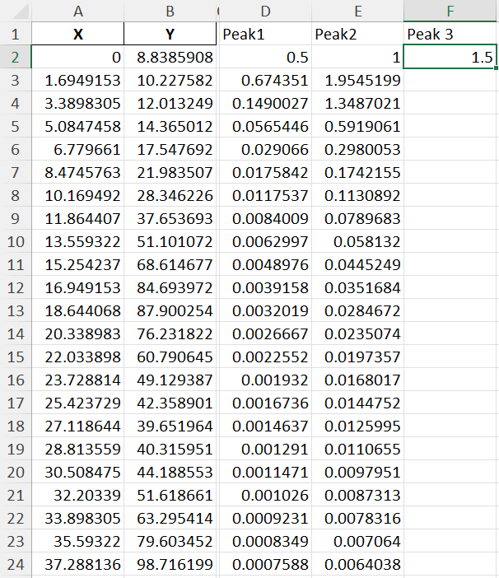

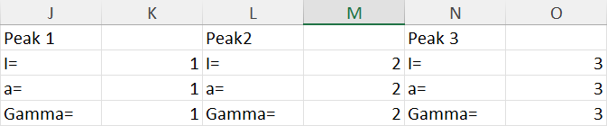

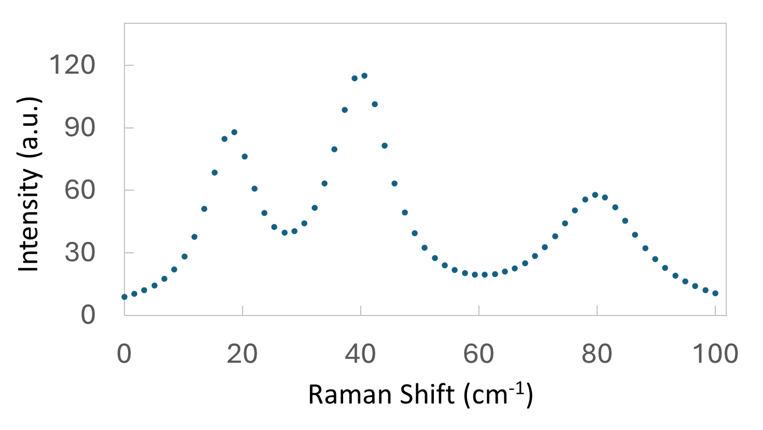
Example for Peak 3
Type in once for each peak.
$s just force the formula not to change from you selected box when you carry down the formula to other cells
I = peak intensity
a = location of peak
Gamma related to peak width
To do the fit we had to enter in our initial guesses, but they didn’t need to be good guesses!

Slide 5
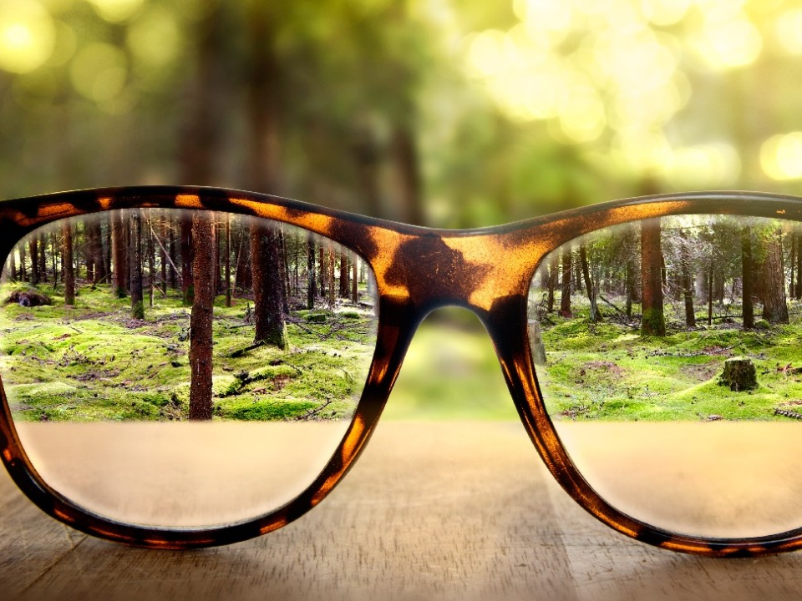
I want to zoom out for a minute and consider the goals of this class.
Notes:
Forest for the trees

Slide 6
Becoming a researcher is like assembling a giant puzzle
At first, all the pieces look random and overwhelming.
You learn to flip pieces over and recognize shapes (research skills!)
Slowly, patterns emerge — and eventually, you help design new pieces that didn’t exist before.
Notes:
This is a process that can’t be mastered in one semester.

Slide 7
Our Primary Skill Focus (Besides Learning What Research is Like)
Learning about (magnetic) materials and methods to characterize them
Learning how to obtain and cite information related to your research
Practicing proper scientific documentation through a lab notebook
Practicing how to graph information for effective scientific communication
Learning how to effectively communicate science research in written and oral form
Notes:
While we have focused on magnetic materials, A LOT of what we’ve learned could be applied to other kinds of materials as well

Slide 8
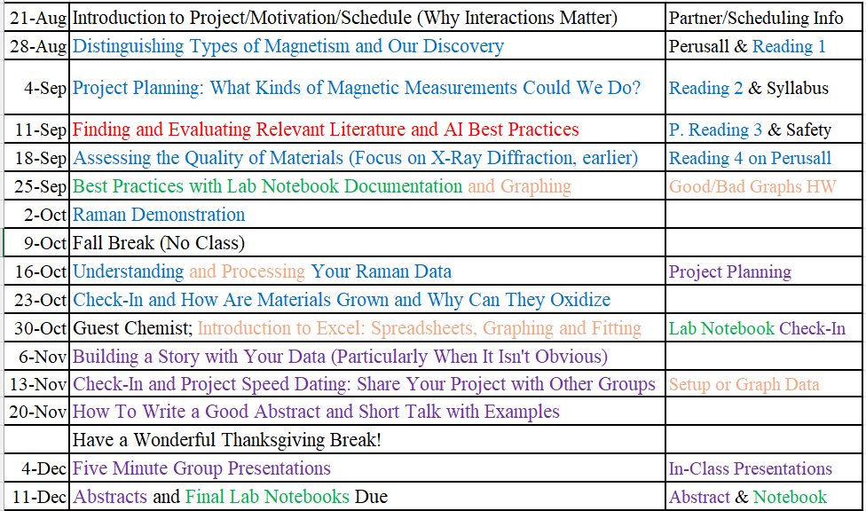
Next week: Practice your elevator pitch. Practice on friends/family members. (graph rubrics on back of lab notebook feedback and website)
We are here
Printed copy please

Slide 9
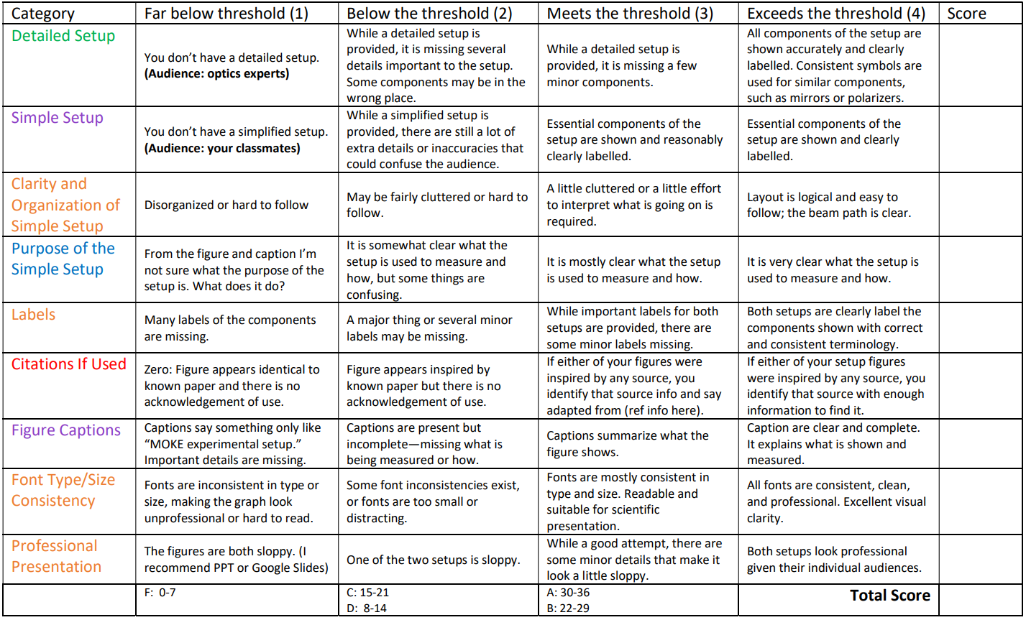
Discuss Experimental Setup Rubric for MOKE since no graphs yet
Important for notebooks
As in a paper
Notes:
Example: irises. Do you think they belong in the simple?

Slide 10
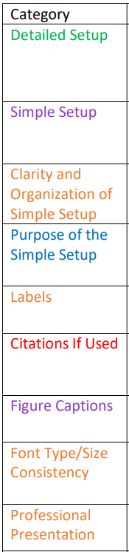
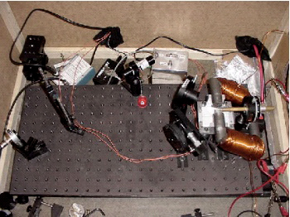
MOKE Setup. We already discussed this was terrible. Don’t do this!
Not clear to most people what we are even looking at. Most pictures are like that.
X
X
X
A picture is useful for your notebooks, BUT it does NOT make a good setup figure!
X

Slide 11
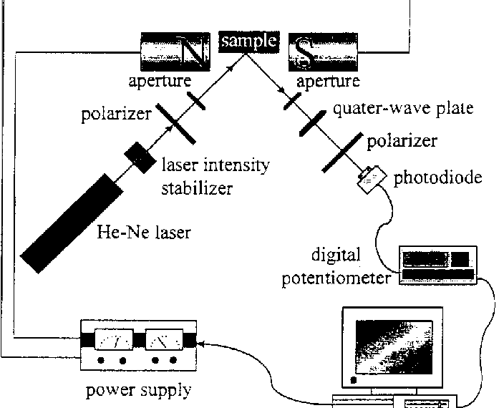
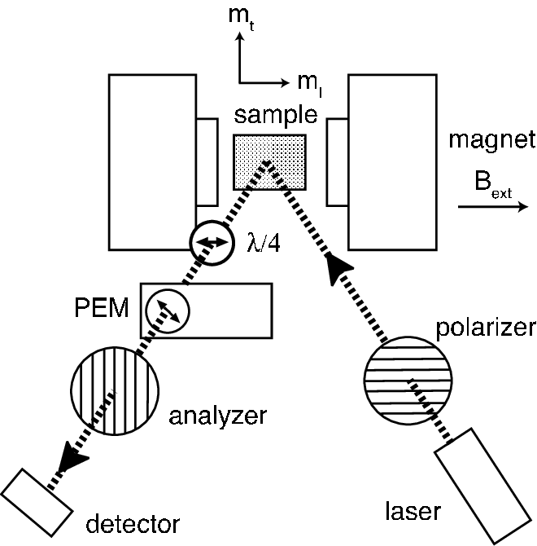
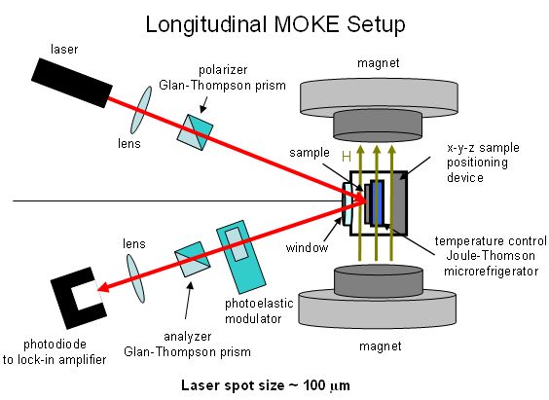
It is totally fine to be inspired by someone else’s work AS LONG AS you cite it. Otherwise, it’s plagiarism!
References in notes
Adapted from reference XXXXXXX
Notes:
Experimental MOKE setup. The quarter wave plate is introduced to... | Download Scientific Diagram
A schematic representation of the MOKE setup. | Download Scientific Diagram
It is totally fine to be inspired by someone else’s work AS LONG AS you cite it. Otherwise, it’s plagiarism!
Include adapted from reference X if appropriate.

Slide 12
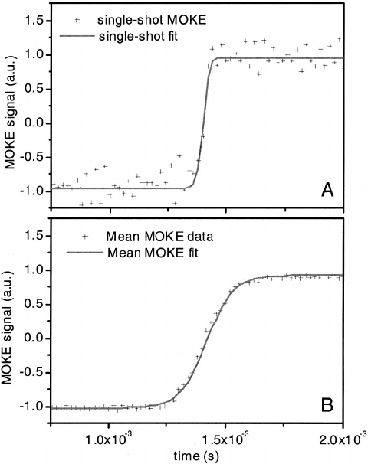
Figures in papers including graphs/setups have captions
Experimental MOKE setup. The quarter wave plate is introduced to measure the Kerr rotation θ instead of the Kerr ellipticity. For clarity, the diaphragm is not shown.
Example MOKE data from the Fe dot sample showing differences between single-shot and averaged MOKE measurements. A) Single-shot measurement points and a fit to the data line, and B) 50-sweep average MOKE signal points and a fit to the data line.
References in notes
Notes:
Experimental MOKE setup. The quarter wave plate is introduced to... | Download Scientific Diagram
Example MOKE data from the Fe dot sample showing differences between... | Download Scientific Diagram
Diaphragm example: https://youtu.be/TDpzgF4vnKc

Slide 13
Reminder of Example from Last Time
Example of a nice graph. What is it missing?
Sometimes it is hard to get your graph do to what you want. No shame in using PPT to edit.
Part of presenting!
Intensity (a.u.)
Raman Shift (cm⁻¹)
Figure 1: Made-up data in order to demonstrate one example of a nice-looking graph. If there were a fit line included, it would be mentioned such as: The solid red line shows the three peak Lorentzian fit to the data.
(Captions go in written presentations, but not in oral presentations.)

Slide 14
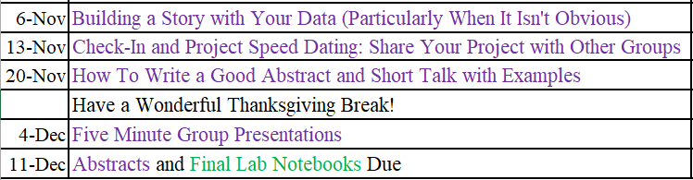
Communicating Guidance
My advice
Practice 1on1
More advice
Presentations
Written
But is this really all of the guidance you’ve gotten on communicating?
Notes:
We’ve been doing it all semester, right?

Slide 15
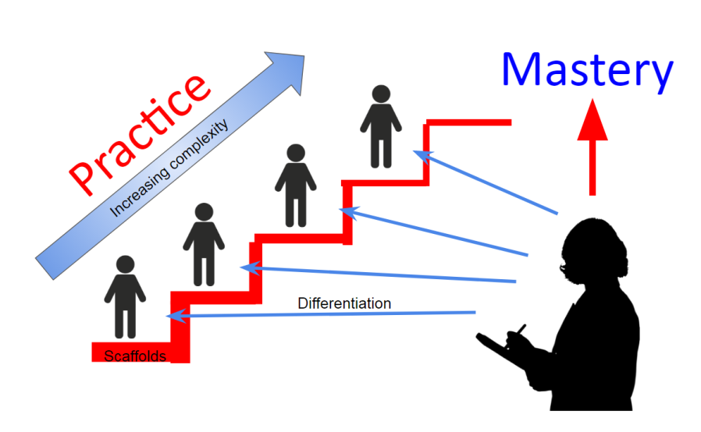
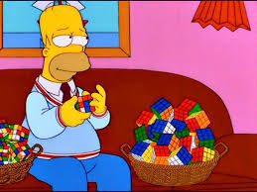
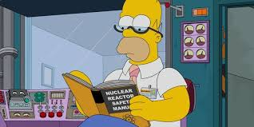
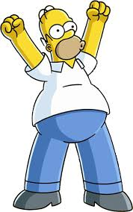
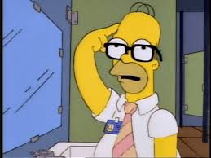
These questions should look familiar.
Why is that important?
What do you expect to learn?
Why are you going to do it?
What research are you going to do?
You are going to do research!
(Start of semester)
You aren’t going to get to mastery in a one credit class, but we can get closer!
Notes:
They might say first either that these are basically the questions from the early notebook rubric or the project proposal. Point out that the overlap was on purpose!

Slide 16
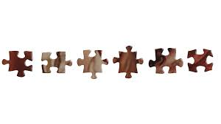
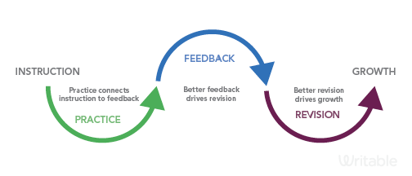
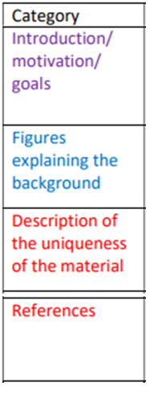
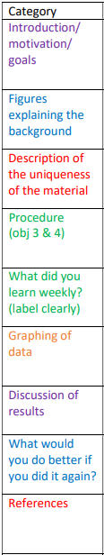
Feedback Scaffolding
How do the pieces fit?
Early Lab
Notebook
Setups (or Graphs)
Final Lab Notebook
Project Proposal
What kinds of measurements are planned?
Why do you think this work could be important?
What do you think you will learn about?
What material will you measure? Why did you pick this material?
Gave feedback if started
Graphs too
Other class goals:
Graphing/presenting ideas
Documenting experiments

Slide 17
Lab Notebook Debrief Only 25% of lab notebook grade
Remember: This assignment is designed to better help you know what I’m looking for before the final lab notebook at the end. It is ok to not do so well on this one, as long as you make sure to learn from the experience as about both the science and what I’m looking for. Let’s say you get an 7.2/10 (low B) on this but 9/10 on final =A for notebook
Most of you did pretty well
A (8.5+/10) 7
B 4
Other 3
(Let’s redo these for up to a B. You are still learning! That’s ok!)

Slide 18
The Value of Peer Assistance
Science is not a lone sport. Even outside of science, you get more done with a good team with complementing strengths than as an individual.
The MOKE setup has been a good example. We are already taking data with only four short meetings, because we had people focus on different aspects on the setup that appeals to their interests or skills.
This is why you have partners.

Slide 19
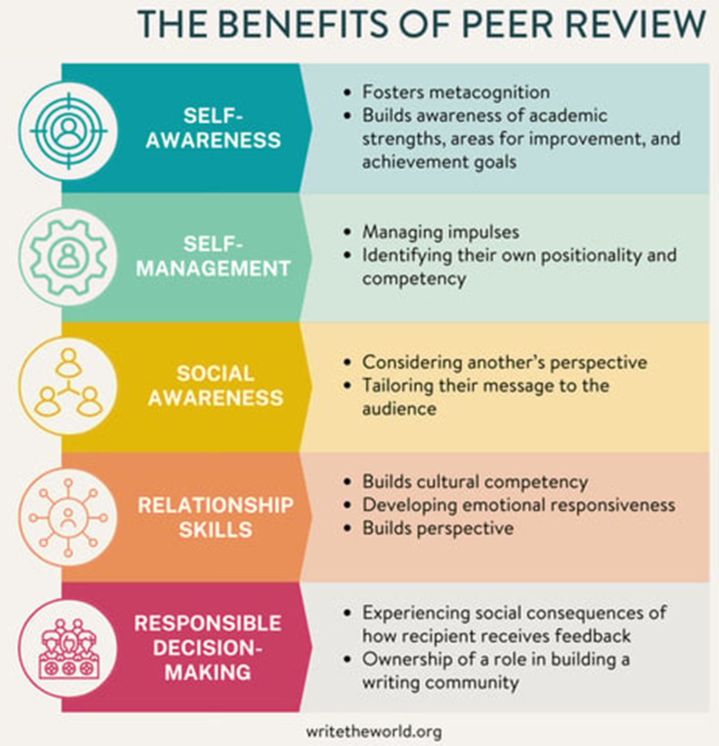
There are many benefits. Here are a few.

Slide 20
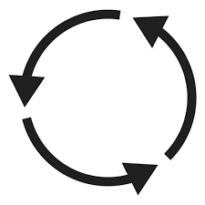

To practice: Switch notebooks with your partner(s)
Spend a few minutes looking.
Discuss what you like from their notebooks and what ideas you have that could improve their points.
Are their goals clear?
The goal here is not to evaluate but to improve.

Slide 21
Confidence Surveys I recognize that the feedback here might be a hit to the ego, and I get that. However, I want to assure you that all of you can still do well as long as you take this as an opportunity to learn how to present your project planning better.
Notes:
A semester in a one credit hour class is a really short amount of time to become expert project planners, however our goal is to get you to think as much about the how and why as possible and present that to your classmates.

Slide 22
Building a Story Particularly When Unclear and/or Unfinished
We always knew it would be hard to finish our projects with a 1-credit hour commitment
Research frequently takes longer than expected
Thus, it’s not uncommon to have to tell an incomplete story at a conference. Think of it as a work in progress. It can be useful to get feedback along the way!

Slide 23
Building a Story When Not Clear or Unfinished (such as MOKE)
Particularly as undergrads doing research, you get a lot of leeway.
We don’t expect you to be experts. However, we do expect you to have a purpose and at least a rough idea of what you expect to see.

Slide 24
Unfinished vs Finished Stories (Preparing for next week’s chats)
Completed Research
Why should I care?
What did you do?
What did you find?
Why are these findings important?
Do any of these questions look familiar?
Incomplete Research
Why should I care?
What did you do or plan to do?
What do you expect to find?
What have you found so far if anything?
What are the next steps?
Why are these steps important?
Notes:
Yes, we’ve been working on story building most of the semester, with multiple opportunities for feedback! While you may not have started having any idea what you were doing (which is normal when first beginning research), you have at least a little better at this over the semester!

Slide 25
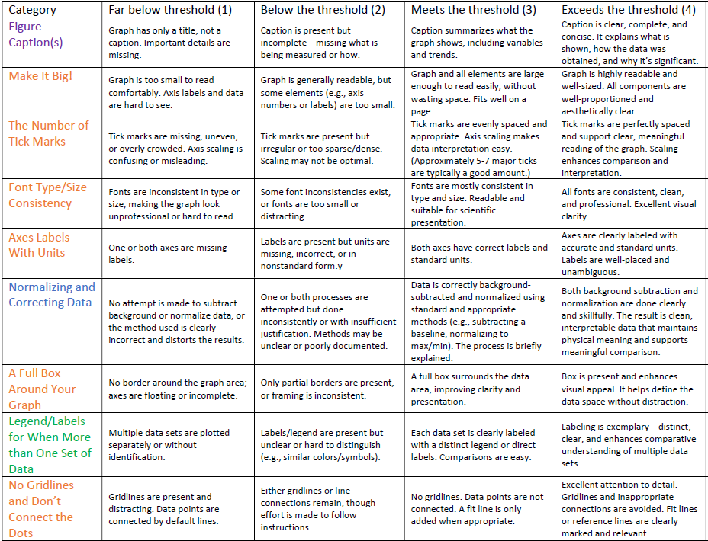
Notes:
Graph rubric

Slide 26
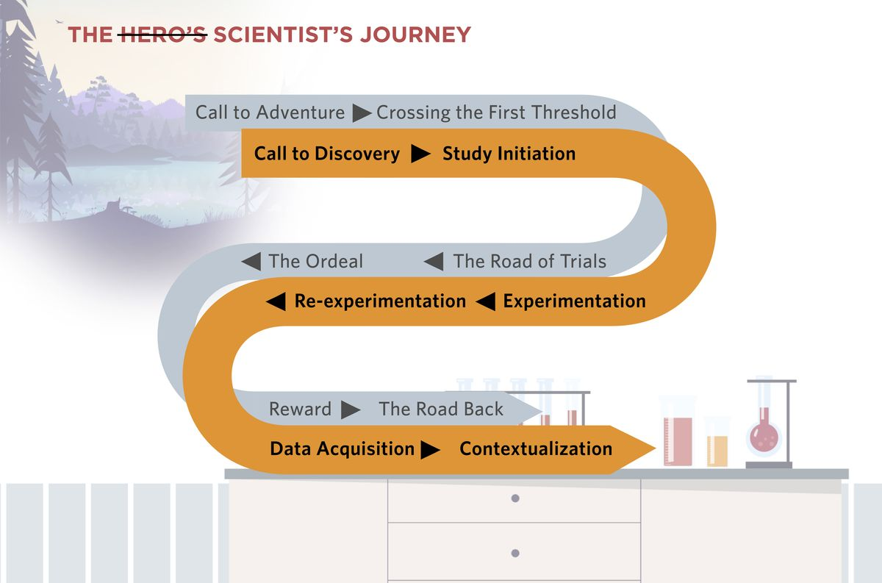

Slide 27
Would you like to work to improve this class?
I do have some funds to improve the class. So if this semester or next year, you’d like to spend some time working on any of the class materials to make anything more clear, please come talk to me. (Minimum wage and we have to set up the paperwork.)
You don’t have to have done well in the class to do this. One that struggled in the class might have the best ideas on how to make it better!
Notes:
Maybe move?

